Slide 1
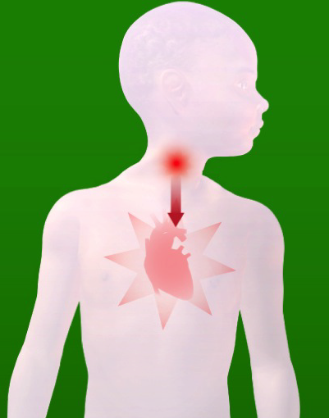

Rheumatic heart disease
How to prevent
Training Program for Healthcare Workers (Nurses, Clinical Officers, Pharmacists, etc.)

Slide 2


What is rheumatic heart disease?
Rheumatic heart disease is also called “RHD.”
RHD is a chronic heart problem. It sometimes needs surgery. It can lead to early death.
RHD is preventable! This training program will tell you how.

Slide 3

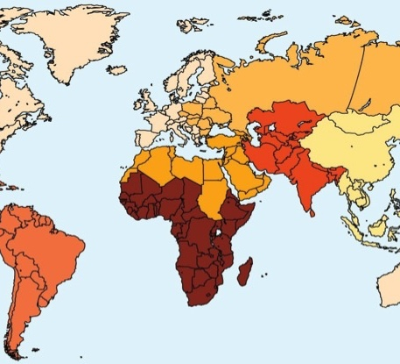
RHD is a global problem
RHD affects 35 million people worldwide and causes about 350,000 deaths each year.*
Africa has very high rates of RHD.
High risk factors for RHD include: overcrowded living conditions, lack of clean water and toilets, and poor access to healthcare
On the map, countries in darker color have more patients with RHD
*Reference: Global Burden of Disease 2015 study. Institute for Health Metrics and Evaluation. http://www.healthdata.org/

Slide 4
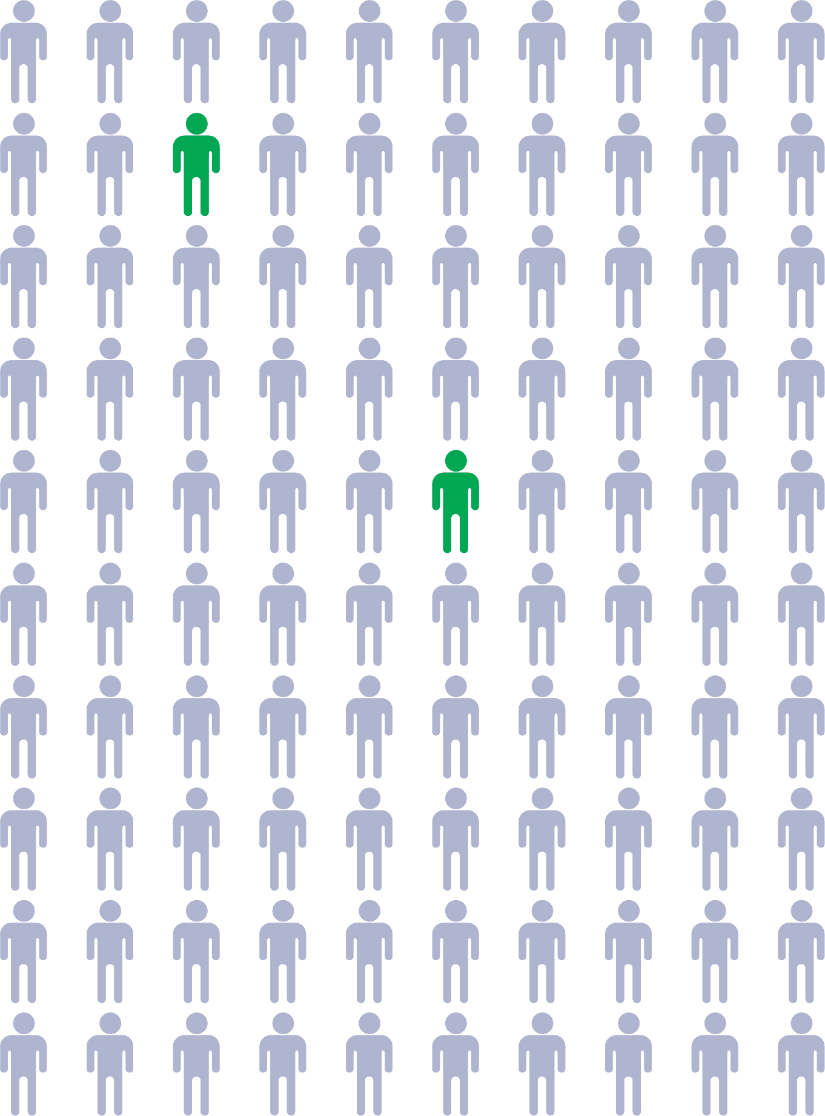
RHD is common in Sub-Saharan Africa
In Africa, up to 1-3% of young people have signs of early RHD.
RHD mostly affects children and young adults.
Once it starts, RHD is hard to treat. This is why it is important to prevent RHD.

Slide 5
RHD is caused by bacterial sore throat
Bacterial sore throat
Acute rheumatic
fever
RHD
Untreated bacterial sore throat can lead to acute rheumatic fever and then to RHD.

Slide 6

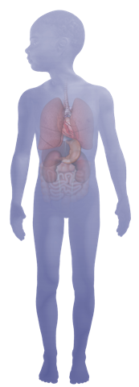
Sore throat is common
Most children get sore throat each year
Sore throat is caused by a bacterium or virus.
Bacterial sore throat can cause RHD.
Viral sore throat cannot cause RHD.
The most common form of bacterial sore throat is called strep throat.
Strep throat can lead to acute rheumatic fever and RHD.
Strep throat mostly affects children 5-15 years old.
1 in 5 sore throats are strep throat.

Slide 7

Untreated strep throat can lead to
Acute rheumatic fever
Acute rheumatic fever develops 1-3 weeks after untreated strep throat in about 3% of patients.
It can cause fever, joint problems, rash, unusual, uncontrolled movements of the body and heart disease.
Patients need urgent medical attention.

Slide 8
Acute rheumatic fever can lead to
Rheumatic heart disease
About 50% of patients with acute rheumatic fever will develop RHD.
RHD causes the heart valves to become “leaky” or “stiff.” It gets worse over time. Surgery is needed in some cases. Many patients with RHD have premature death.
The most common symptom of RHD is shortness of breath.
RHD is entirely preventable.

Slide 9
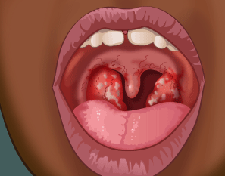
Review
RHD is caused by bacterial sore throat
RHD is caused by untreated bacterial sore throat.
The specific form of bacterial sore throat that causes RHD is called “strep.”
To prevent RHD, treatment for strep throat must be prompt and appropriate.
Exercise: what is is abnormal in the photo?

Slide 10

To prevent RHD
Treat strep throat promptly with penicillin
Strep throat must be treated within about 9 days in order to prevent RHD
9
Injectable Benzathine penicillin G should be considered for patients who are unlikely to complete a 10-day course of oral therapy and for patients with personal or family histories of rheumatic fever or RHD or environmental factors (such as crowded living conditions or low socioeconomic status) that place them at enhanced risk for rheumatic fever.*
* Reference: Prevention of Rheumatic Fever and Diagnosis and Treatment of Acute Streptococcal Pharyngitis
Michael A. Gerber, Robert S. Baltimore, Charles B. Eaton, Michael Gewitz, Anne H. Rowley, Stanford T. Shulman and Kathryn A. Taubert
Circulation. 2009;119:1541-1551, originally published March 23, 2009
https://doi.org/10.1161/CIRCULATIONAHA.109.191959

Slide 11
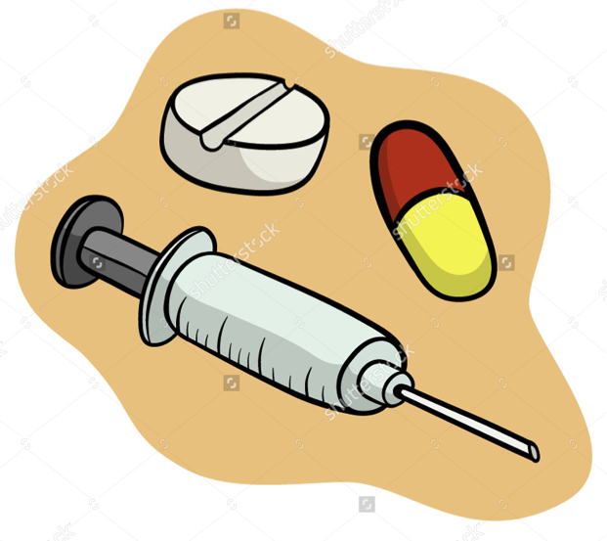
To prevent RHD
Treat strep throat promptly with penicillin
Strep throat must be treated with an antibiotic.
Penicillin is the preferred antibiotic.
Pain is one of the major problems when intramuscular BPG is given. Health professionals who administer intramuscular BPG on a regular basis should consider using 1% lignocaine hydrochloride as a diluent instead of sterile water in order to minimise the pain of injection.
* Reference: Advice to health professionals: Use of lignocaine as a diluent to reduce the pain associated with the administration of benzathine penicillin G. Geoffrey Madeira, Ana Olga Mocumbi, Bongani Mayosi . S Afr Med J 2016;106(7):742. DOI:10.7196/SAMJ.2016.v106i7.10864 http://www.pascar.org/uploads/files/Madeira_201608_SAMJ_Advice_to_health_professionals_-_Use_of_lignocaine_as_a_diluent_to_reduce_the_pain_associated_with_the_administration_of_benzathine_penicillin_G_.pdf

Slide 12
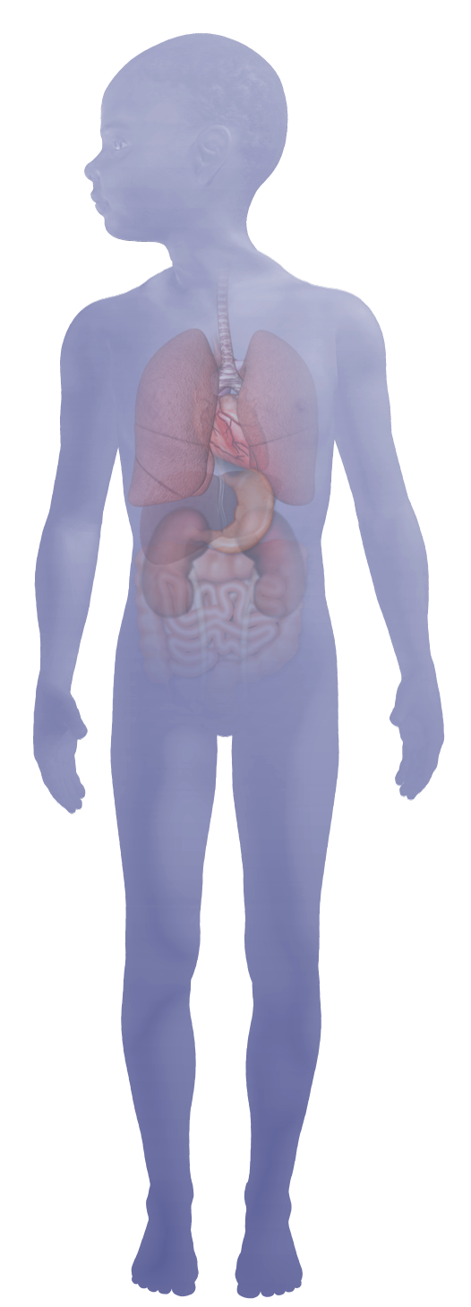
Comparing bacterial and viral sore throat
Give penicillin only for bacterial sore throat
Signs of bacterial
(strep) sore throat:
Red throat
White patches on tonsils
Tender, swollen glands
Scarlet fever rash
Abdominal pain
Signs of viral
sore throat:
  Runny nose
  Cough
  Itchy, watery eyes
  Fever (nonspecific)
  Sick family members
Treatment with penicillin is needed
No antibiotic treatment needed

Slide 13
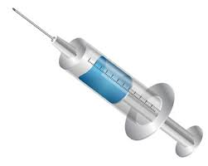

How to prevent further infections and heart damage
Give a penicillin injection or tablets
IM Injection – One dose
Benzathine Penicillin *¹
<30 kg: 600,000 units
>30 kg: 1.2 million units
Oral dose Penicillin V –
Duration: 10 days ¹
<27kg: 250mg 2-3 times per day
>27kg: 500mg 2-3 times day
* No test dose is needed.
*The patient does not need to take extra food
before the injection.
*Patients do not develop resistance to
Benzathine Penicillin
¹Reference: Prevention of Rheumatic Fever and Diagnosis and Treatment of Acute Streptococcal Pharyngitis
Michael A. Gerber, Robert S. Baltimore, Charles B. Eaton, Michael Gewitz, Anne H. Rowley, Stanford T. Shulman and Kathryn A. Taubert
Circulation. 2009;119:1541-1551, originally published March 23, 2009
https://doi.org/10.1161/CIRCULATIONAHA.109.191959

Slide 14
In the event of penicillin allergy
Give alternate medications
Agent | Dose | Mode
Erythromycin¹ | >30 kg: 500mg b.d. or 250 mg q.i.d. <30 kg: 125mg q.i.d. | Oral
Clindamycin² | 20 mg/kg per day divided in 3 doses (1.8 g/d) | Oral for a duration of 10 days
Azithromycin² | 12 mg/kg once daily (maximum 500 mg) | Oral for a duration of 5 days
Clarithromycin² | 15 mg/kg per day divided BID (maximum 250 mg BID) | Oral for a duration of 10 days
¹Reference: Mayosi, “Protocols for antibiotic
use in primary and secondary prevention for
rheumatic fever”, SAMJ 2006
²Reference: Prevention of Rheumatic Fever and Diagnosis and Treatment of Acute Streptococcal Pharyngitis
Michael A. Gerber, Robert S. Baltimore, Charles B. Eaton, Michael Gewitz, Anne H. Rowley, Stanford T. Shulman and Kathryn A. Taubert
Circulation. 2009;119:1541-1551, originally published March 23, 2009
https://doi.org/10.1161/CIRCULATIONAHA.109.191959

Slide 15
How to prevent further infections and heart damage
Give monthly penicillin injections
Without treatment, patients with RHD usually suffer worsening heart disease over time.
Treatment for RHD is a monthly injection of penicillin. This usually does not cure RHD, but it can help stop it from getting worse.
Some patients also need other heart medications and surgery.

Slide 16
For a patient who has RHD
Give secondary prevention as long as needed
according to WHO guidelines
Category of patient | Duration of secondary prevention
Patient without proven carditis | For 5 years after last attack, or until 18 years of age (whichever is longer)
Patient with mild carditis* | For 10 years after the last attack, or at least until 25 years of age (whichever is longer)
More severe valvular disease | Lifelong
After valve surgery | Lifelong
*Carditis is inflammation of muscle tissue in the heart. Mild carditis in an RHD patient
is described as mitral valve regurgitation or healed carditis.
Reference: Mayosi, “Protocols for antibiotic use in primary and secondary prevention for rheumatic fever”, SAMJ 2006. http://www.samj.org.za/index.php/samj/article/viewFile/1389/813

Slide 17
?
Review quiz
Key messages: Questions
Is RHD preventable?
Can bacterial (strep) sore throat lead to RHD?
Can viral sore throat lead to RHD?
What is the preferred treatment of strep throat?
Out of 100 schoolchildren, about how many are expected to have RHD?

Slide 18
Review quiz
Key messages: Answers
Question | Answer
Is RHD preventable? | Yes
Can bacterial (strep) sore throat lead to RHD? | Yes
Can viral sore throat lead to RHD? | No
What is the preferred treatment of strep throat? | Injectable penicillin
Out of 100 schoolchildren, about how many are expected to have RHD? | 1 or 2

Slide 19
For more information about RHD
Contact the BeatRHD Team
Email:
Call: +

Slide 20
Supplementary materials
Advanced concepts

Slide 21
RHD pathway
Origin: RHD is a complication of untreated streptococcal (“strep”) sore throat.
Primordial prevention: Improved living conditions (i.e., reduced poverty, nutrition, overcrowding) decreases risk of strep sore throat.
Primary prevention: Prompt treatment of patients with sore throat prevents acute rheumatic fever and RHD. Single-dose injectable benzathine penicillin is preferred to ensure compliance.
Secondary prevention: Monthly penicillin injections for a period of years or decades reduces progression of heart disease in patients with RHD.
Tertiary intervention: Special heart medications and surgery are sometimes needed for patients with advanced RHD. Left untreated, progressive RHD is often fatal.
Pathway to the development of RHD and intervention nodes for prevention
Environmental conditions
Primordial
prevention
Group A Streptococcal pharyngitis
Primary
prevention
Acute rheumatic fever/RHD
Secondary
prevention
Cardiac surgery
Tertiary
intervention

Slide 22

This Rheumatic Heart Disease Training Module
for Healthcare Workers was created by the
BeatRHD Zambia team
at the University Teaching Hospital, Lusaka, Zambia
Dr. John Musuku, Consultant Paediatrician/Cardiologist, PI
University Teaching Hospital
Department of Paediatrics & Child Health
P/B RW I Lusaka
+260 0966 766052
jmusuku2001@yahoo.co.uk

